Slide 1

Microsoft vs. Nintendo vs. Sony
Rachel Goodridge
Notes:
My name is Rachel and I’ve been studying the competition happening between Microsoft, Nintendo, and Sony. Hoping to help Microsoft become a stronger competitor against these two.

Slide 2
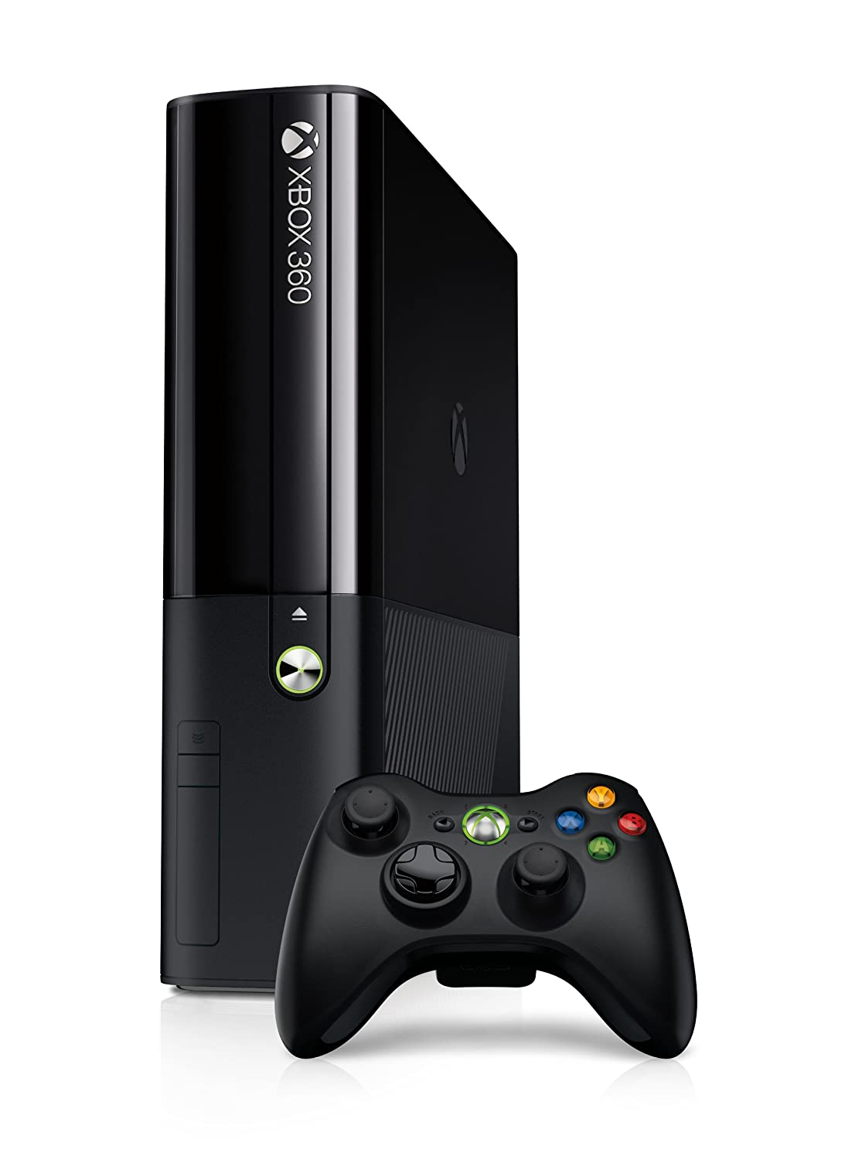
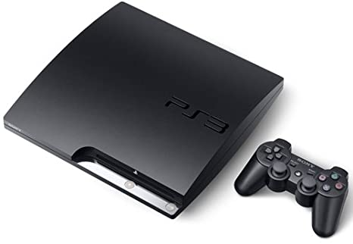
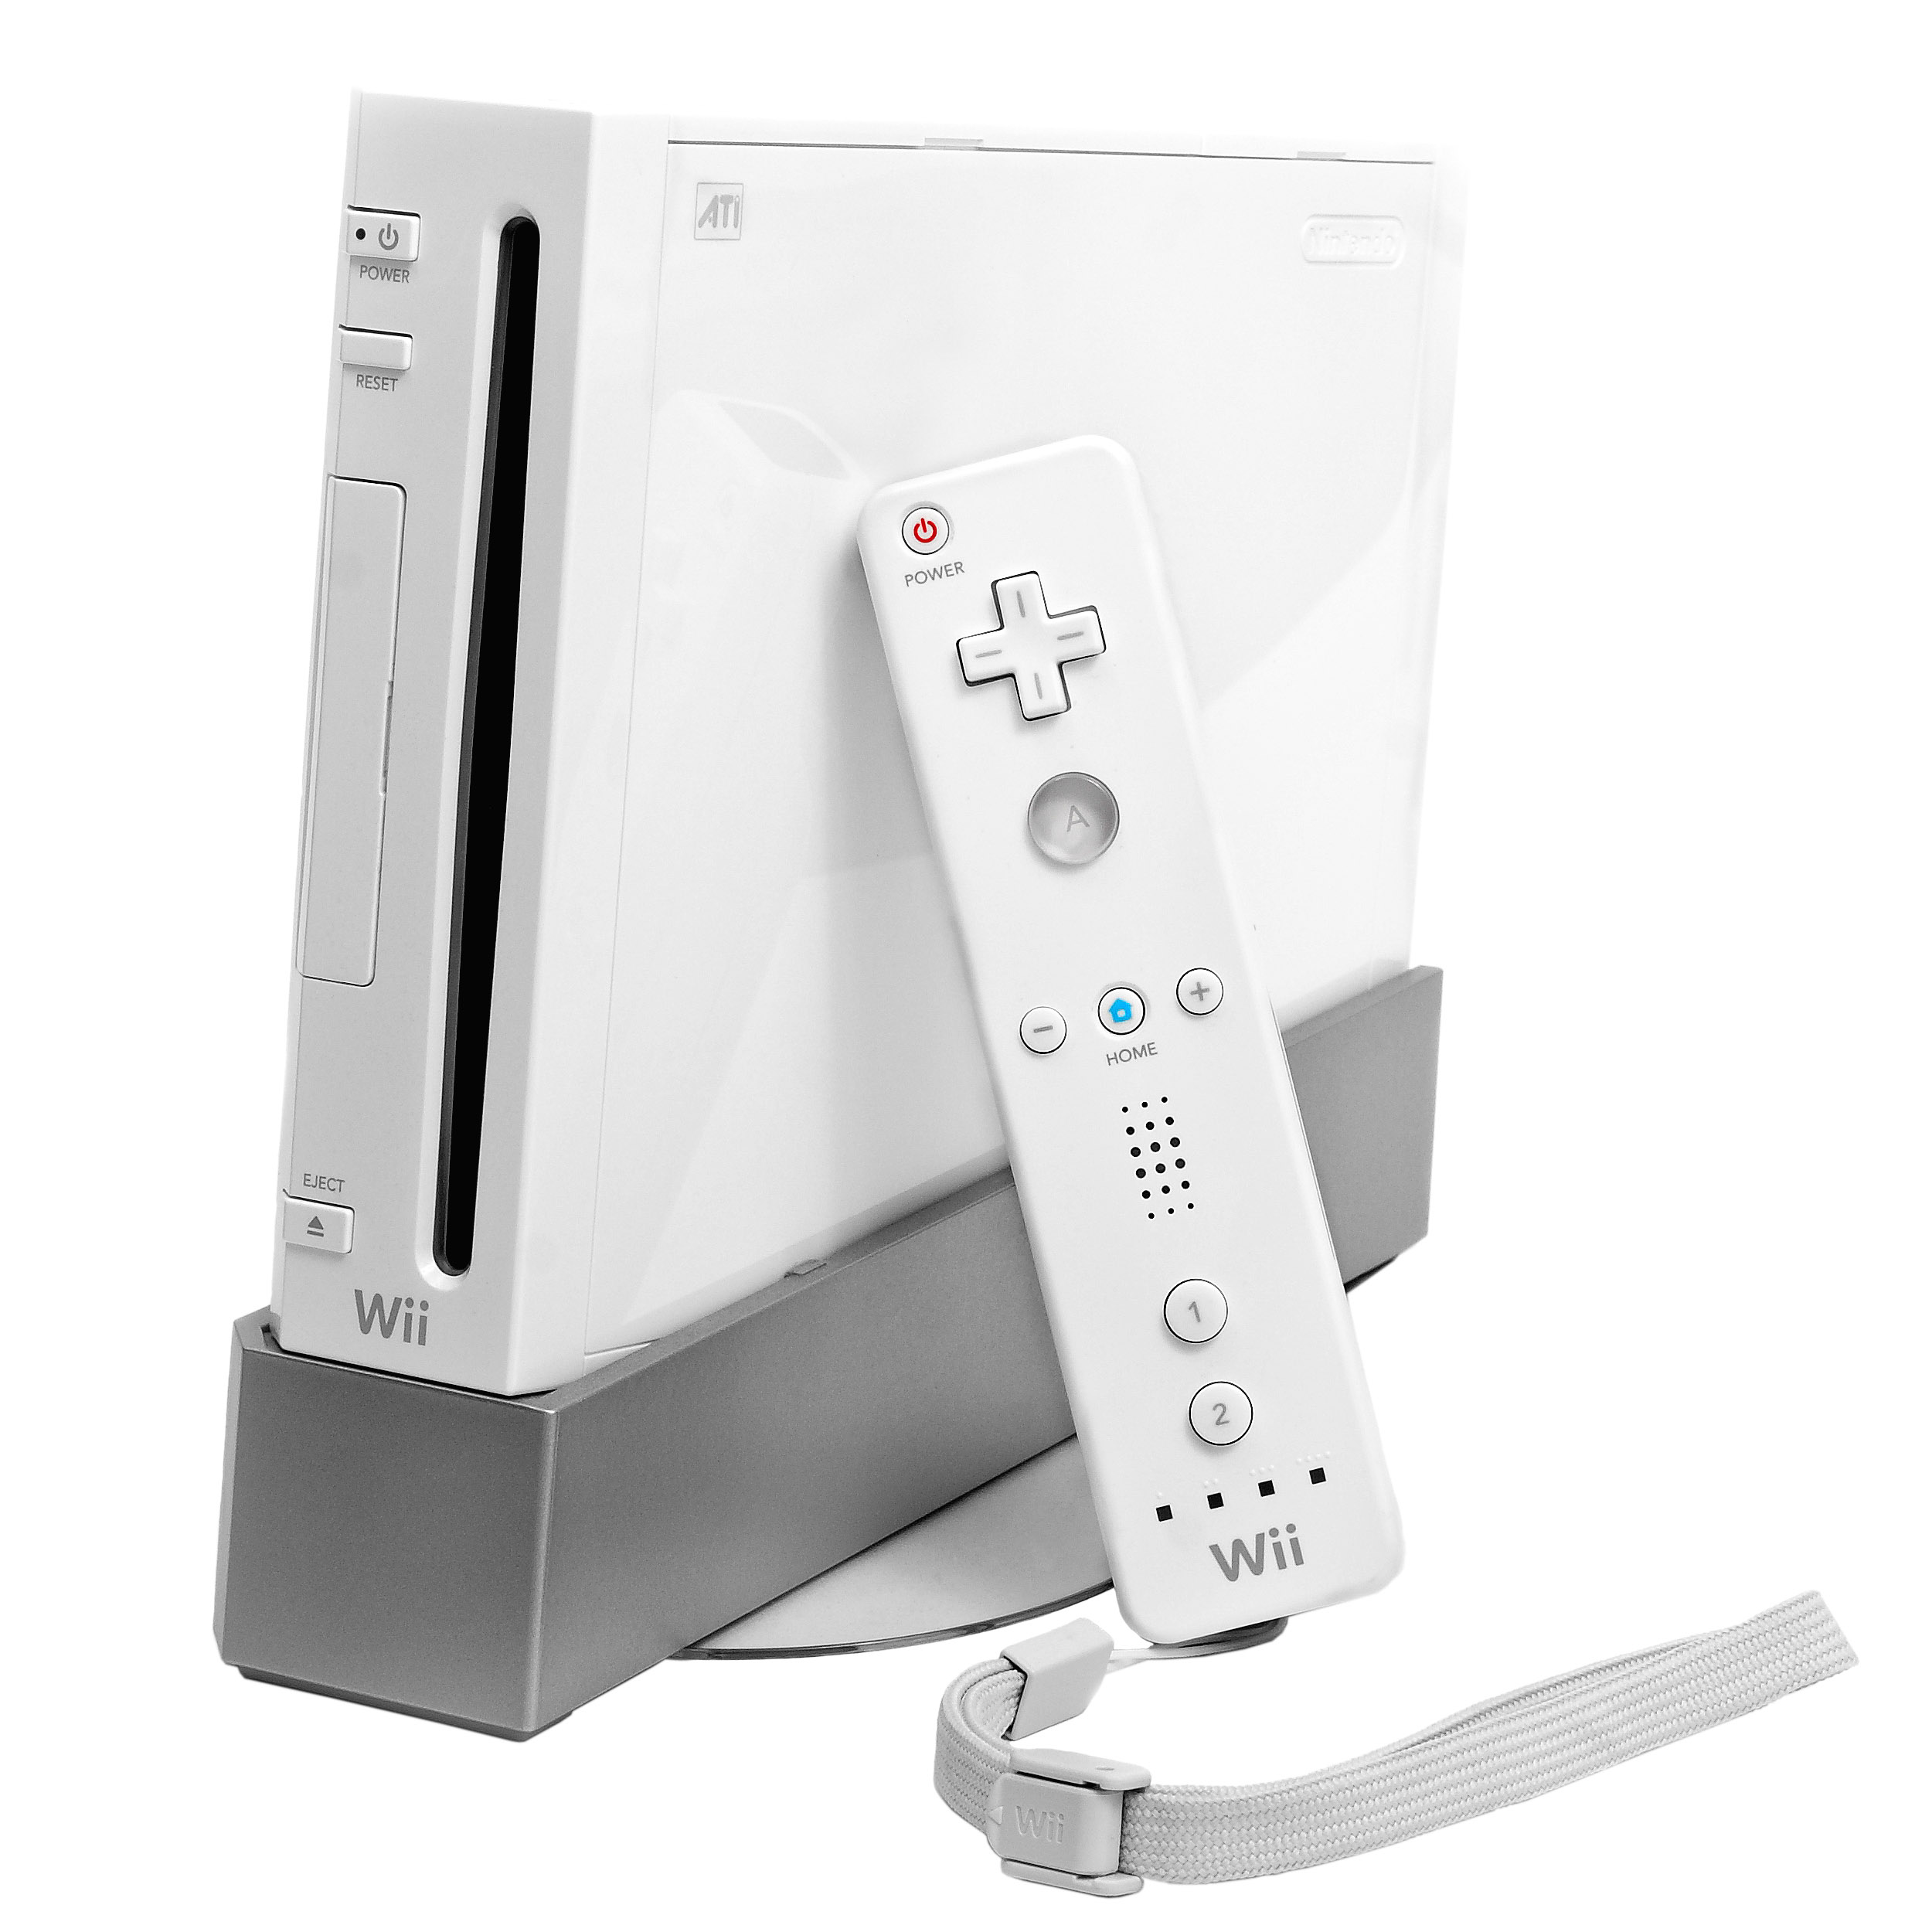
Flashback to the 2006 Console Wars
> 84 million sold
> 87 million sold
> 101 million sold
Notes:
Microsoft has not ”won” any of the console wars. With the 2006 war as an example, X360 has sold over 84 million consoles to-date which is less than the PS3 at 87 and the Wii at 101.

Slide 3
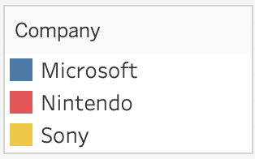
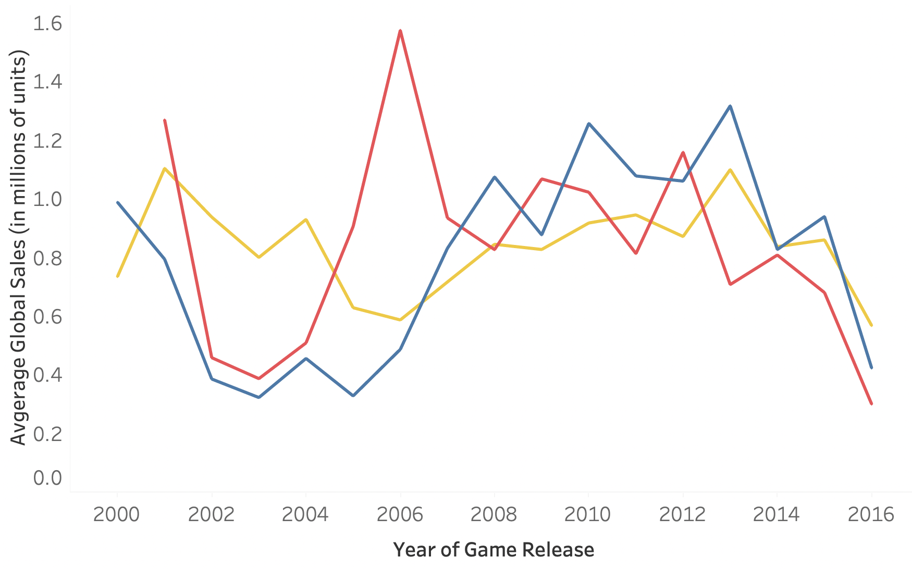
Turbulent History
Wii
X360
WiiU
PS2
XOne
PS3
PS4
3DS
XB
Notes:
Turns out profit is made from game sales, not from consoles. So to look at average global sales in millions, we can see the competition is fierce. Here sections of the graph are labeled to correspond to times when specific consoles were dominating the market.

Slide 4

Three-Pronged Solution Path
Problem
What can give Microsoft an advantage over Nintendo and Sony?
Notes:
Here is my three-pronged proposal to help Microsoft rise above its competitors and get some insight that could bring an advantage over Nintendo and Sony.

Slide 5


Three-Pronged Solution Path
Problem
Impact
Improving upon current popular games and the diversity of games available may increase the number of people playing or rate at which people purchase Xbox games.
What can give Microsoft an advantage over Nintendo and Sony?

Slide 6


Three-Pronged Solution Path
Problem
Impact
Data
Improving upon current popular games and the diversity of games available may increase the number of people playing or rate at which people purchase Xbox games.
Collect dataset from Kaggle about games sold on different platforms including genre, sales, critic scores, and ratings.
What can give Microsoft an advantage over Nintendo and Sony?

Slide 7


Three-Pronged Solution Path
Problem
Impact
Data
EDA
Improving upon current popular games and the diversity of games available may increase the number of people playing or rate at which people purchase Xbox games.
Use Google Sheets and Tableau to perform some Exploratory Data Analysis and observe patterns.
Collect dataset from Kaggle about games sold on different platforms including genre, sales, critic scores, and ratings.
What can give Microsoft an advantage over Nintendo and Sony?

Slide 8


Three-Pronged Solution Path
Grouping
Use unsupervised machine learning to cluster games into categories and treat each category with a specific growth strategy.
Problem
Impact
Data
EDA
Improving upon current popular games and the diversity of games available may increase the number of people playing or rate at which people purchase Xbox games.
Use Google Sheets and Tableau to perform some Exploratory Data Analysis and observe patterns.
Collect dataset from Kaggle about games sold on different platforms including genre, sales, critic scores, and ratings.
What can give Microsoft an advantage over Nintendo and Sony?

Slide 9


Three-Pronged Solution Path
Grouping
Use unsupervised machine learning to cluster games into categories and treat each category with a specific growth strategy.
Problem
Impact
Data
EDA
Prediction
Use time series analysis to predict the growth rate of different game categories and game sales rate in different consoles.
Improving upon current popular games and the diversity of games available may increase the number of people playing or rate at which people purchase Xbox games.
Use Google Sheets and Tableau to perform some Exploratory Data Analysis and observe patterns.
Collect dataset from Kaggle about games sold on different platforms including genre, sales, critic scores, and ratings.
What can give Microsoft an advantage over Nintendo and Sony?

Slide 10


Three-Pronged Solution Path
Grouping
Use unsupervised machine learning to cluster games into categories and treat each category with a specific growth strategy.
Problem
Impact
Data
EDA
Prediction
Use time series analysis to predict the growth rate of different game categories and game sales rate in different consoles.
Improving upon current popular games and the diversity of games available may increase the number of people playing or rate at which people purchase Xbox games.
Use Google Sheets and Tableau to perform some Exploratory Data Analysis and observe patterns.
Collect dataset from Kaggle about games sold on different platforms including genre, sales, critic scores, and ratings.
What can give Microsoft an advantage over Nintendo and Sony?
Use Natural Language Processing on game reviews to discover what people do and don’t like about specific game types and consoles.
NLP

Slide 11
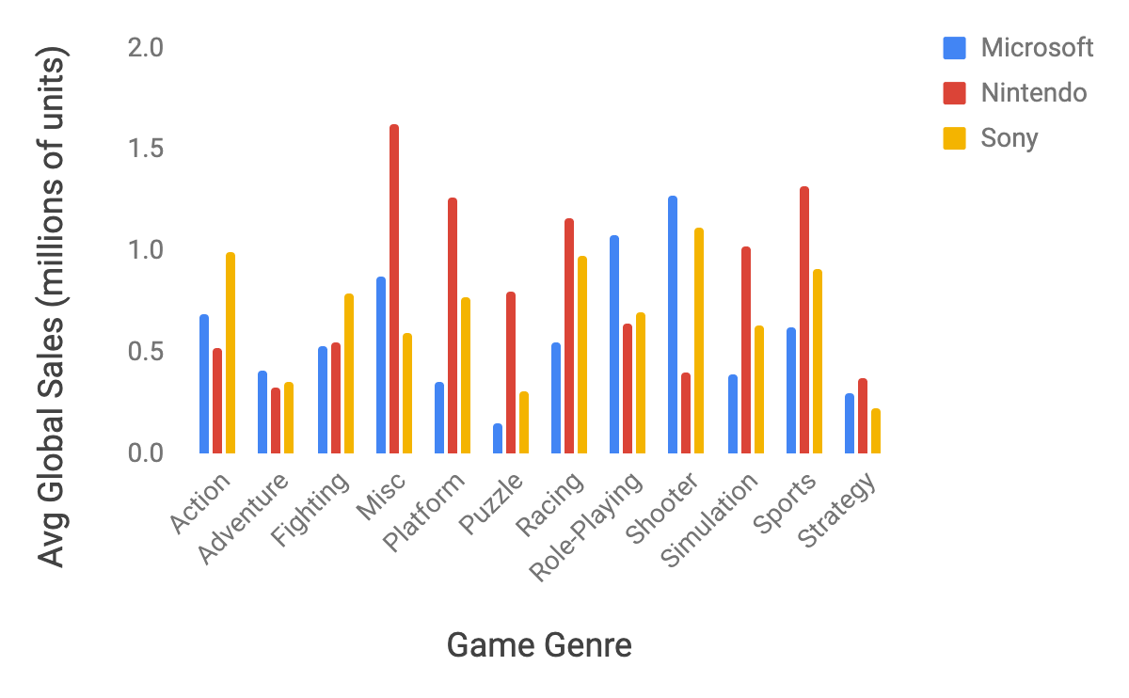
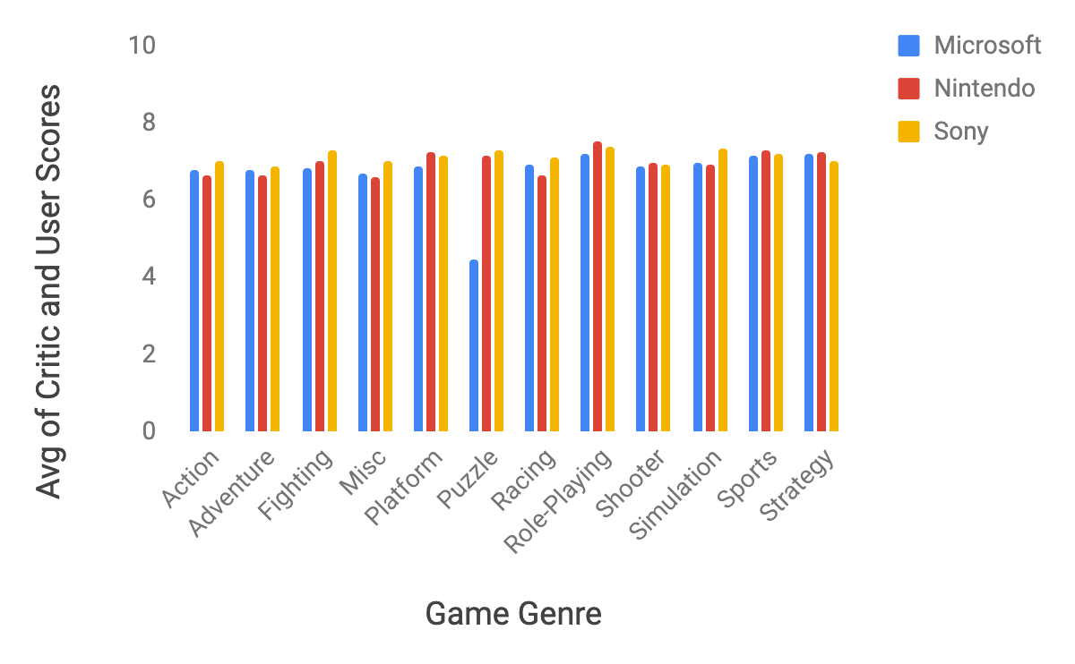
Game Comparison by Genre

Slide 12
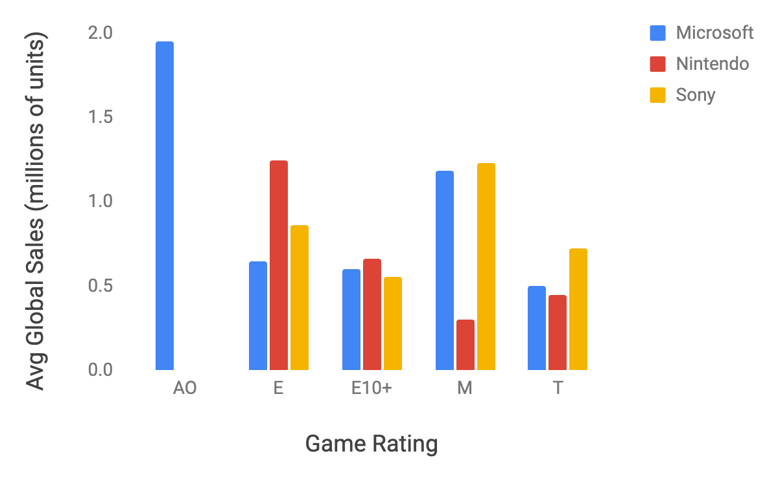
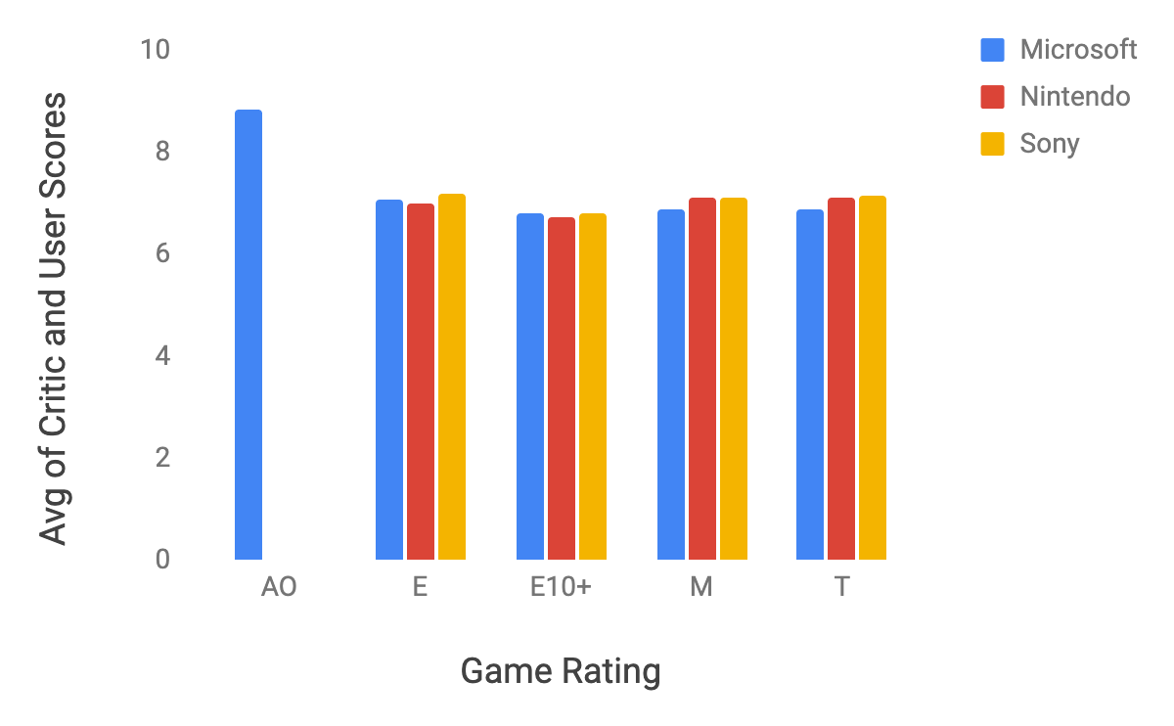
Game Comparison by Rating

Slide 13
Conclusions from Initial Analysis
If game diversification is the goal, Microsoft should focus on . . .
Platform games
Puzzle games
Racing games
Simulation games
Sports games
Games rated for everyone
Games rated for teens
If game specialization is the goal, Microsoft should focus on . . .
Role-playing games
Shooter games
Games rated for adults only
Games rated for mature audiences

Slide 14
Thank you

Slide 15

Appendix

Slide 16
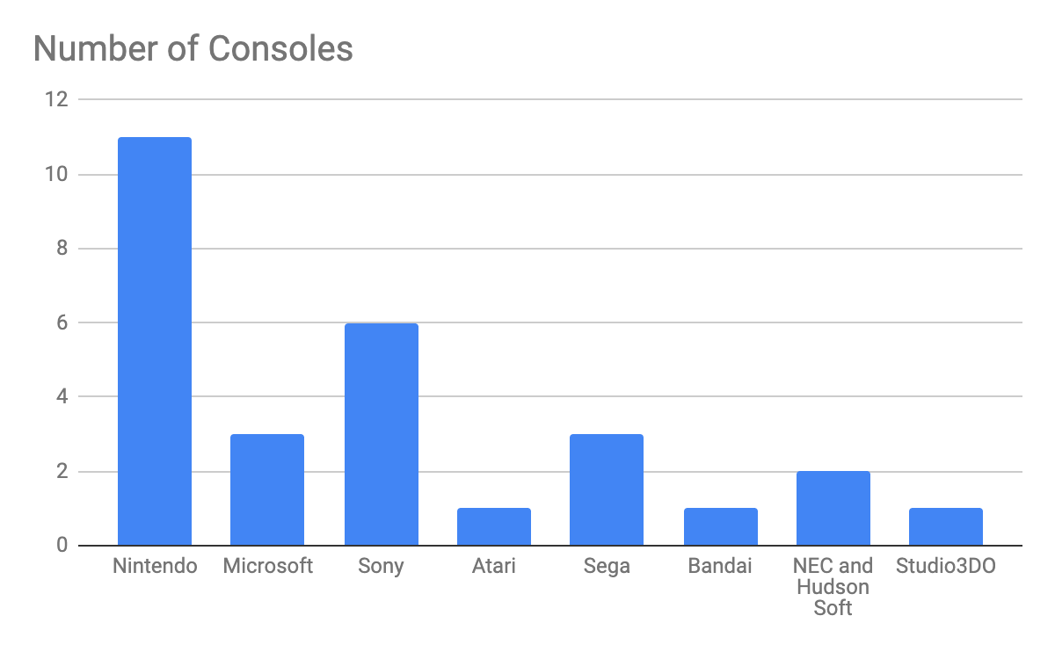
Consoles
Console | Company | Full Name of Console
Wii | Nintendo | Wii
NES | Nintendo | Nintendo Entertainment System
GB | Nintendo | Game Boy
DS | Nintendo | DS
X360 | Microsoft | Xbox 360
PS3 | Sony | PlayStation 3
PS2 | Sony | PlayStation 2
SNES | Nintendo | Super Nintendo Entertainment System
GBA | Nintendo | Game Boy Advance
PS4 | Sony | PlayStation 4
3DS | Nintendo | 3DS
N64 | Nintendo | Nintendo 64
PS | Sony | PlayStation
XB | Microsoft | Xbox
PC
2600 | Atari
PSP | Sony | PlayStation Portable
XOne | Microsoft | Xbox One
WiiU | Nintendo | Wii U
GC | Nintendo | GameCube
GEN
DC | Sega
PSV | Sony | PlayStation Vita
SAT | Sega
SCD | Nintendo | Supplemental Computing Device
WS | Bandai
NG
TG16 | NEC and Hudson Soft
3DO | Studio3DO
GG | Sega
PCFX | NEC and Hudson Soft

Slide 17
Pivot Tables (part I)
Company | AVERAGE of Global_Sales | AVERAGE of Critic_User_Score
Nintendo | 0.8587979684 | 6.969567508
Sony | 0.854828938 | 7.115632253
Microsoft | 0.755335019 | 6.924912649
Grand Total | 0.8304188312 | 7.024634665
Platform | AVERAGE of Global_Sales | AVERAGE of Critic_User_Score
PS | 1.377 | 7.709264843
Wii | 1.375741127 | 6.638129374
PS3 | 1.019895969 | 6.86109255
PS4 | 1.016861925 | 6.791304551
X360 | 0.9945221445 | 6.75080646
PS2 | 0.8297982456 | 7.271640478
DS | 0.823987069 | 6.835160984
XOne | 0.8149056604 | 6.595433975
3DS | 0.7950322581 | 6.881489354
WiiU | 0.7424719101 | 7.033392159
GBA | 0.555907173 | 7.352195238
PSP | 0.4818461538 | 7.056094546
GC | 0.4581034483 | 7.367304407
XB | 0.3753451327 | 7.28202808
PSV | 0.2616949153 | 7.36631693
Grand Total | 0.8304188312 | 7.024634665

Slide 18
Pivot Tables (part II)
Genre | AVERAGE of Global_Sales | AVERAGE of Critic_User_Score
Misc | 1.084619423 | 6.782640256
Shooter | 1.062792916 | 6.921030368
Platform | 0.9622959184 | 7.154501597
Sports | 0.9039606127 | 7.202485189
Racing | 0.8821641791 | 6.951582038
Action | 0.78514 | 6.852820348
Simulation | 0.7423853211 | 7.073968844
Role-Playing | 0.729616 | 7.404518391
Puzzle | 0.6904385965 | 7.116434112
Fighting | 0.6682573727 | 7.111389537
Adventure | 0.3529411765 | 6.768338894
Strategy | 0.2910526316 | 7.138413423
Grand Total | 0.8304188312 | 7.024634665
Rating | AVERAGE of Global_Sales | AVERAGE of Critic_User_Score
AO | 1.95 | 8.830681818
M | 1.133067227 | 7.020042806
E | 0.981706209 | 7.080611121
E10+ | 0.6121453287 | 6.780765442
T | 0.6080103725 | 7.073764095
Grand Total | 0.8304188312 | 7.024634665

Slide 19
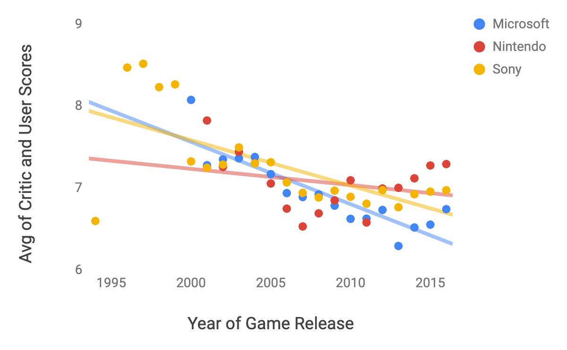
Time Series

Slide 20
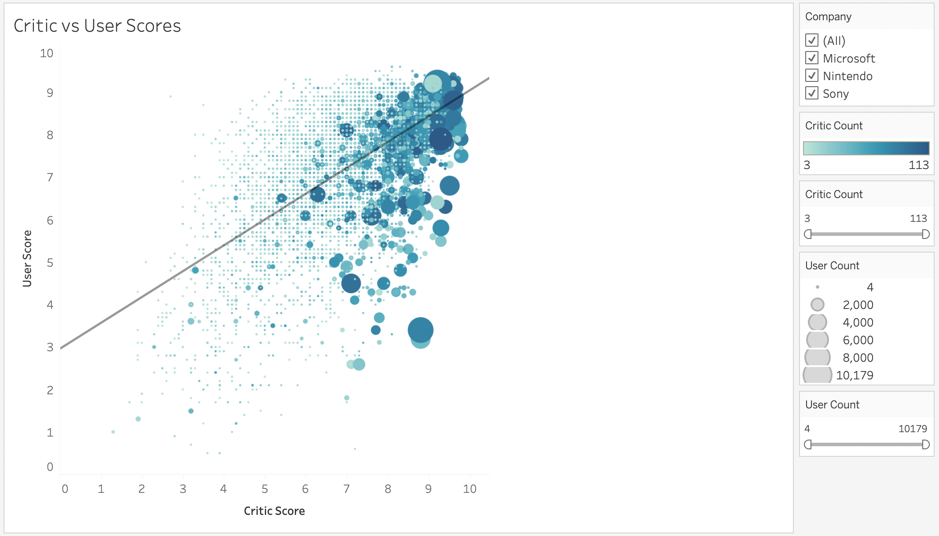

Slide 21
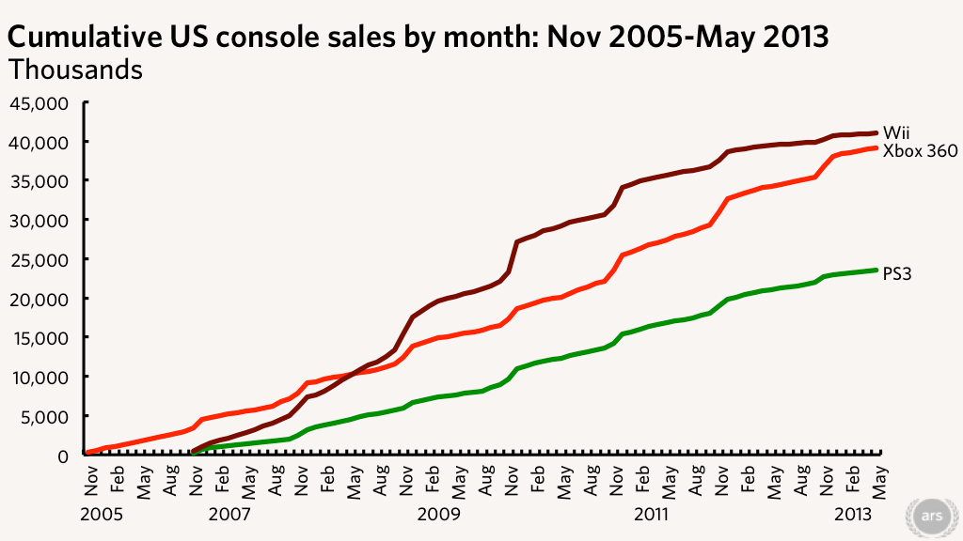
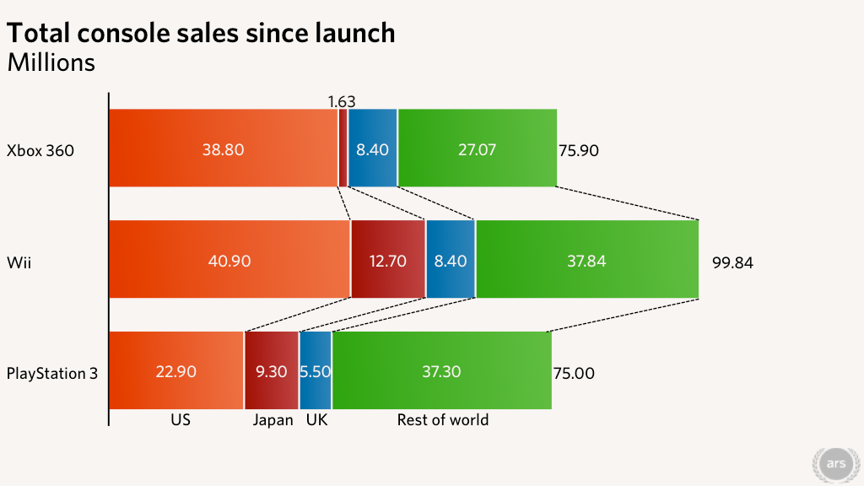
Xbox 360 vs Wii vs PlayStation 3
Kyle Orland - Jun 27, 2013 9:56 pm UTC, and sominiArs Centurion jump to post. “Analysis: Xbox 360 Poised to Pass Wii in US Sales by Year's End.” Ars Technica, 27 June 2013, https://arstechnica.com/gaming/2013/06/analysis-xbox-360-poised-to-pass-wii-in-us-sales-by-years-end/.

Slide 22
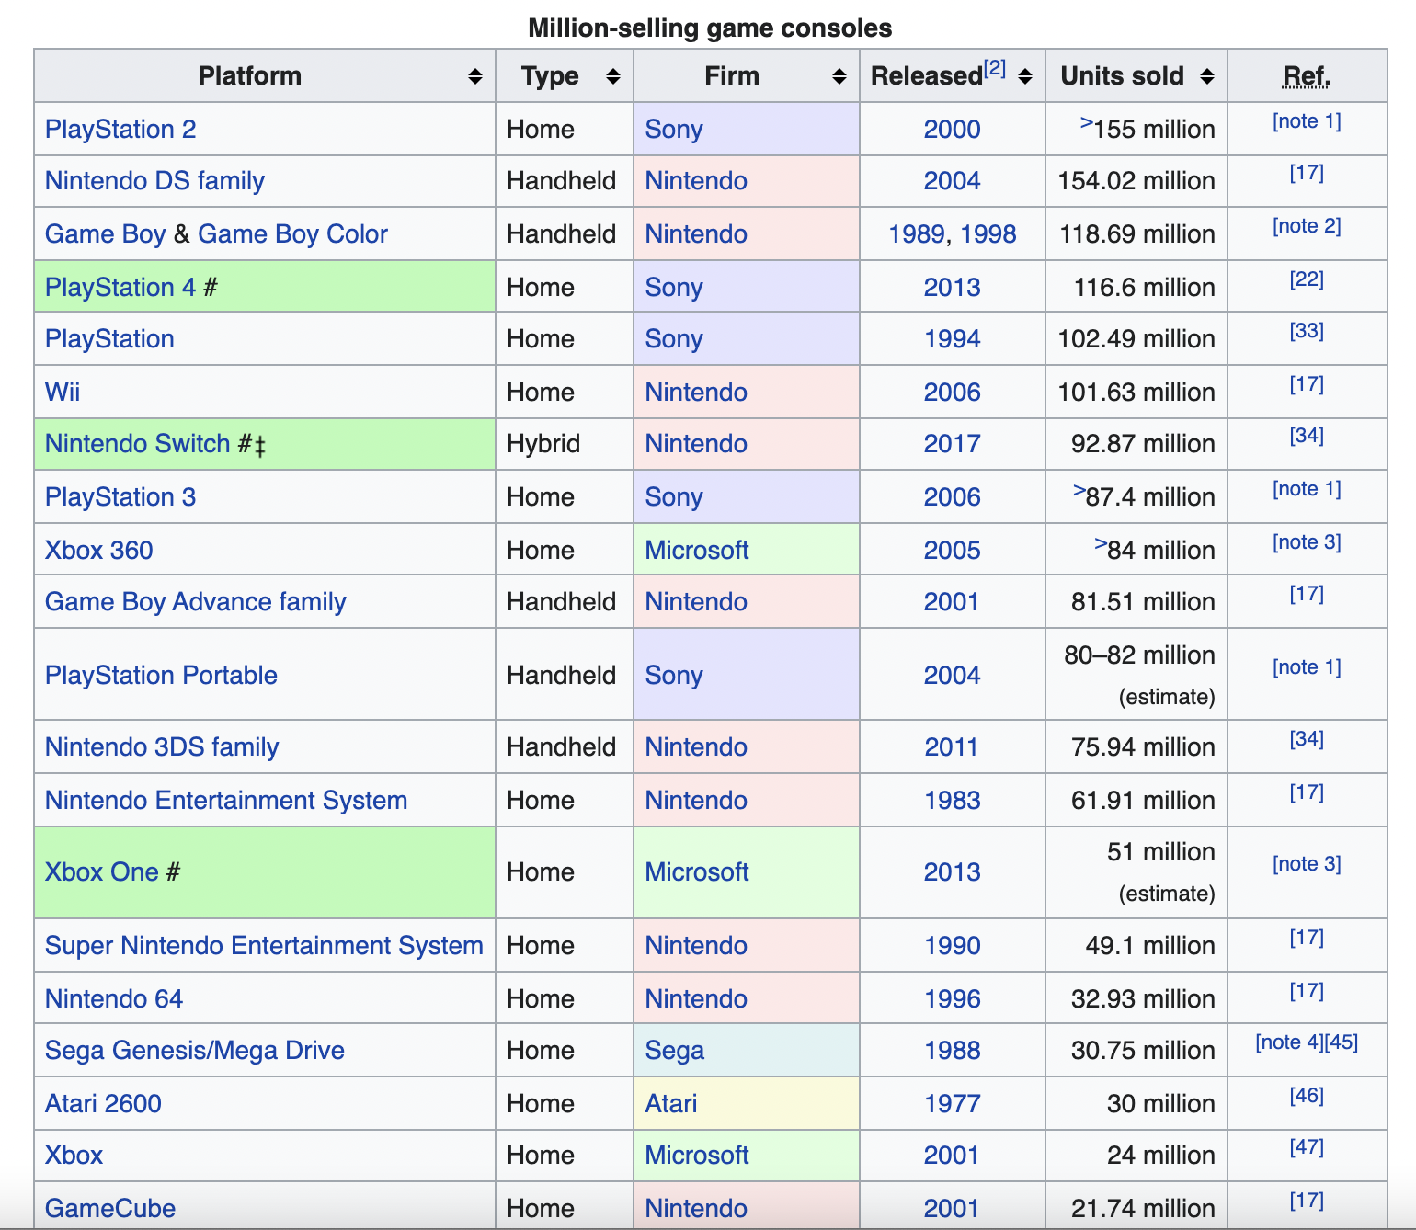
Console Sales
“List of Best-Selling Game Consoles.” Wikipedia, Wikimedia Foundation, 6 Nov. 2021, https://en.wikipedia.org/wiki/List_of_best-selling_game_consoles.

Slide 23
Cost-Benefit Analysis
Microsoft doesn't make profit from console sales. They may even lose money, because it is so expensive to make quality electronics. This is just how they attract new customers.
Profits are made from game sales and online service subscriptions. Microsoft takes a 30% cut from all games and in-game purchases sold through the console's store under its standard developer agreement. Developers would be given a deal by Microsoft, so they would be paid to have their game appear on Game Pass.
Microsoft also gets about 45% from physical copies of games purchased. As long as people are buying games, Microsoft will make money, whether you buy the Blu-Ray / physical disc version or purchase it digitally through the online store.
For example, the Xbox 360 is about $180 and Microsoft takes roughly a $126 hit per console sold. Current games cost $60 on average and Microsoft gets 30% from each game, so about $18 per game profit. This means users would need to buy at least 7 games to make up for the loss of the console sale.

Slide 24
Criteria for Success
Measure the current rate of game sales on all consoles as a baseline.
Success would be increasing this rate of game sales (ideally on all consoles, but overall is fine).
Measure the overall net profit made per month compared to Nintendo and Sony.
Success would be a higher rate of profit increase (need to adjust for inflation).

Slide 25
Assumptions
We assume that focusing efforts on game availability and diversification will not only attract new customers, but also encourage existing customers to purchase additional games.
We assume that adapting to the style of the competitors will have a positive impact.
We also assume that the number of consoles owned by each company does not play a role in this. (Nintendo has developed far more gaming consoles than Microsoft or Sony, so this may bring them an advantage by sheer numbers.)

Slide 26

Risks
Microsoft seems to have a niche gaming audience that we could potentially start to lose if energy is spent diversifying too widely.
Maybe the available games are not the reason for disinterest in Microsoft products. In this case, changing the games available would not address the problem.
We don't want quality or other areas to decline because of this shift in focus.

Slide 27
Future Directions : An Argument for Diversification
Microsoft is moving towards cloud gaming.
Xbox Game Pass is a video game subscription service from Microsoft for use with its Xbox Series X/S and Xbox One consoles, Windows 11 and Windows 10, as well as Android and iOS devices via Xbox Cloud Gaming. It costs $120 per year.
Subscribers to Xbox Game Pass are playing 40% more games (including titles outside the Game Pass catalogue) than they did before joining.
An impressive 91% of subscribers say they have played a title they would not have tried without Xbox Game Pass, while Microsoft has noticed members are playing 30% more genres than they did before joining.

